Slide 1
Chapter 3 Process Description and Control
Operating Systems: Internals and Design Principles
Seventh Edition
By William Stallings
Notes:
“Operating Systems: Internal and Design Principles”, 7/e, by William Stallings, Chapter 3 “Process Description and Control”.

Slide 2
Process Elements
We can think of process as an entity that consists of a number of elements
Two essential elements of a process are:
When the processor begins to execute the program code, we refer to this executing entity as a process
Program code
which may be shared with other processes that are executing the same program
A set of data associated with that code
Notes:
Recall from Chapter 2 that we suggested several definitions of the term process ,
including
• A program in execution
• An instance of a program running on a computer
• The entity that can be assigned to and executed on a processor
• A unit of activity characterized by the execution of a sequence of instructions,
a current state, and an associated set of system resources
We can also think of a process as an entity that consists of a number of elements.
Two essential elements of a process are program code (which may be shared with
other processes that are executing the same program) and a set of data associated
with that code. Let us suppose that the processor begins to execute this program
code, and we refer to this executing entity as a process.

Slide 3
Process Elements
While the program is executing, this process can be uniquely characterized by a number of elements, including:
identifier
state
priority
program counter
memory pointers
context data
I/O status information
accounting information
Notes:
At any given point in time,
while the program is executing , this process can be uniquely characterized by a
number of elements, including the following:
• Identifier: A unique identifier associated with this process, to distinguish it
from all other processes.
• State: If the process is currently executing, it is in the running state.
• Priority: Priority level relative to other processes.
• Program counter: The address of the next instruction in the program to be
executed.
• Memory pointers: Includes pointers to the program code and data associated
with this process, plus any memory blocks shared with other processes.
• Context data: These are data that are present in registers in the processor
while the process is executing.
• I/O status information: Includes outstanding I/O requests, I/O devices (e.g.,
disk drives) assigned to this process, a list of files in use by the process, and
so on.
• Accounting information: May include the amount of processor time and clock
time used, time limits, account numbers, and so on.

Slide 4
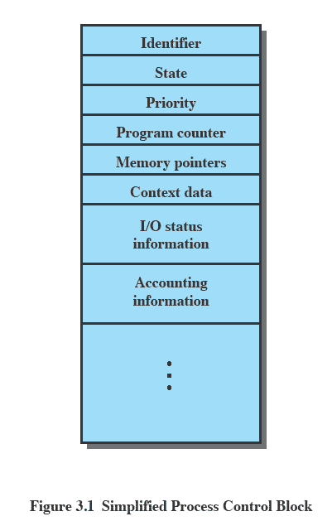
Process Control Block
Contains the process elements
Makes it possible to interrupt a running process and later resume execution as if the interruption had not occurred
Created and managed by the operating system
Key tool that allows support for multiple processes (multiprogramming)
Notes:
The information in the preceding list is stored in a data structure, typically
called a process control block ( Figure 3.1 ), that is created and managed by the OS.
The significant point about the process control block is that it contains sufficient
information so that it is possible to interrupt a running process and later resume
execution as if the interruption had not occurred. The process control block is
the key tool that enables the OS to support multiple processes and to provide for
multiprocessing. When a process is interrupted, the current values of the program
counter and the processor registers (context data) are saved in the appropriate fields
of the corresponding process control block, and the state of the process is changed
to some other value, such as blocked or ready (described subsequently). The OS is
now free to put some other process in the running state. The program counter and
context data for this process are loaded into the processor registers and this process
now begins to execute.
Thus, we can say that a process consists of program code and associated data
plus a process control block. For a single-processor computer, at any given time, at
most one process is executing and that process is in the running state.

Slide 5
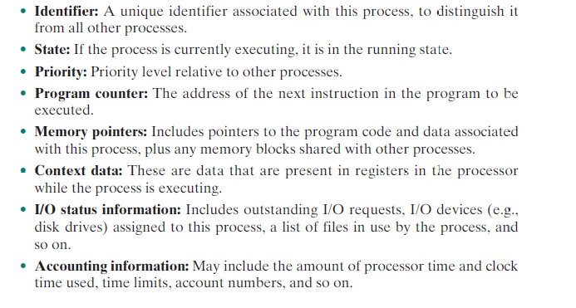
Process Control Block
Notes:
The information in the preceding list is stored in a data structure, typically
called a process control block ( Figure 3.1 ), that is created and managed by the OS.
The significant point about the process control block is that it contains sufficient
information so that it is possible to interrupt a running process and later resume
execution as if the interruption had not occurred. The process control block is
the key tool that enables the OS to support multiple processes and to provide for
multiprocessing. When a process is interrupted, the current values of the program
counter and the processor registers (context data) are saved in the appropriate fields
of the corresponding process control block, and the state of the process is changed
to some other value, such as blocked or ready (described subsequently). The OS is
now free to put some other process in the running state. The program counter and
context data for this process are loaded into the processor registers and this process
now begins to execute.
Thus, we can say that a process consists of program code and associated data
plus a process control block. For a single-processor computer, at any given time, at
most one process is executing and that process is in the running state.

Slide 6
Process States
Trace
the behavior of an individual process can be characterized by listing the sequence of instructions that execute for that process
the behavior of the processor can be characterized by showing how the traces of the various processes are interleaved
Dispatcher
small program that switches the processor from one process to another
Notes:
As just discussed, for a program to be executed, a process, or task, is created for
that program. From the processor’s point of view, it executes instructions from its
repertoire in some sequence dictated by the changing values in the program counter
register. Over time, the program counter may refer to code in different programs
that are part of different processes. From the point of view of an individual program,
its execution involves a sequence of instructions within that program.
We can characterize the behavior of an individual process by listing the
sequence of instructions that execute for that process. Such a listing is referred to
as a trace of the process. We can characterize behavior of the processor by showing
how the traces of the various processes are interleaved.

Slide 7
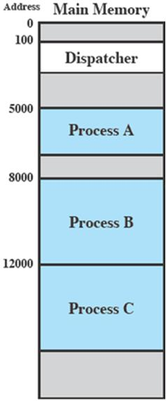
Process Execution
Notes:
Let us consider a very simple example. Figure 3.2 shows a memory layout
of three processes. To simplify the discussion, we assume no use of virtual memory;
thus all three processes are represented by programs that are fully loaded
in main memory. In addition, there is a small dispatcher program that switches
the processor from one process to another.

Slide 8
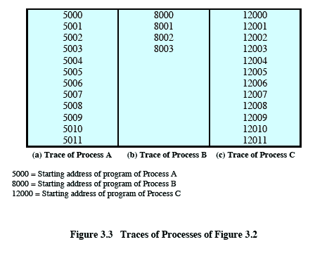
Traces of Processes of Figure 3.2
Each process runs to completion
Figure 3.3
Notes:
Figure 3.3 shows the traces of each
of the processes during the early part of their execution. The first 12 instructions
executed in processes A and C are shown. Process B executes four instructions,
and we assume that the fourth instruction invokes an I/O operation for which the
process must wait.

Slide 9
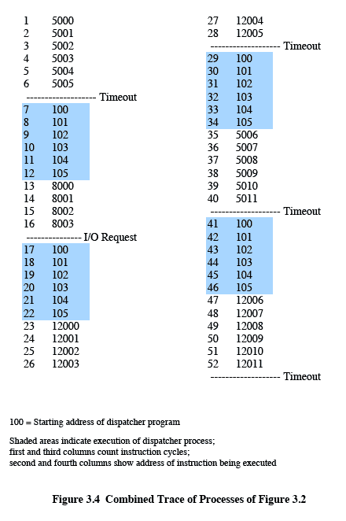
Combined Trace of Processes of Figure 3.2
Figure 3.4
Notes:
Now let us view these traces from the processor’s point of view. Figure 3.4
shows the interleaved traces resulting from the first 52 instruction cycles (for convenience,
the instruction cycles are numbered). In this figure, the shaded areas
represent code executed by the dispatcher. The same sequence of instructions is
executed by the dispatcher in each instance because the same functionality of the
dispatcher is being executed. We assume that the OS only allows a process to continue
execution for a maximum of six instruction cycles, after which it is interrupted;
this prevents any single process from monopolizing processor time. As Figure 3.4
shows, the first six instructions of process A are executed, followed by a time-out
and the execution of some code in the dispatcher, which executes six instructions
before turning control to process B. 2 After four instructions are executed, process
B requests an I/O action for which it must wait. Therefore, the processor stops
executing process B and moves on, via the dispatcher, to process C. After a timeout,
the processor moves back to process A. When this process times out, process
B is still waiting for the I/O operation to complete, so the dispatcher moves on to
process C again.

Slide 10
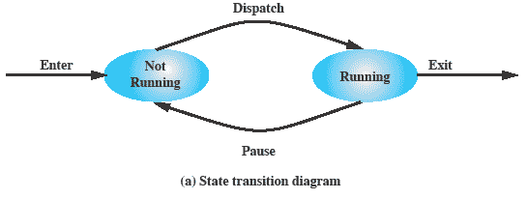
Two-State Process Model
A process may be in one of two states:
running
not-running
Notes:
The operating system’s principal responsibility is controlling the execution of
processes; this includes determining the interleaving pattern for execution and allocating
resources to processes. The first step in designing an OS to control processes
is to describe the behavior that we would like the processes to exhibit.
We can construct the simplest possible model by observing that, at any time, a
process is either being executed by a processor or not. In this model, a process may
be in one of two states: Running or Not Running, as shown in Figure 3.5a . When
the OS creates a new process, it creates a process control block for the process and
enters that process into the system in the Not Running state. The process exists,
is known to the OS, and is waiting for an opportunity to execute. From time to
time, the currently running process will be interrupted and the dispatcher portion
of the OS will select some other process to run. The former process moves from the
Running state to the Not Running state, and one of the other processes moves to
the Running state.

Slide 11
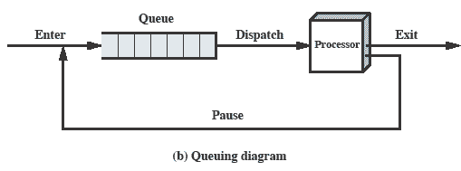
Queuing Diagram
Notes:
From this simple model, we can already begin to appreciate some of the design
elements of the OS. Each process must be represented in some way so that the OS
can keep track of it. That is, there must be some information relating to each process,
including current state and location in memory; this is the process control block.
Processes that are not running must be kept in some sort of queue, waiting their turn
to execute. Figure 3.5b suggests a structure. There is a single queue in which each
entry is a pointer to the process control block of a particular process. Alternatively,
the queue may consist of a linked list of data blocks, in which each block represents
one process; we will explore this latter implementation subsequently.
We can describe the behavior of the dispatcher in terms of this queuing
diagram. A process that is interrupted is transferred to the queue of waiting processes.
Alternatively, if the process has completed or aborted, it is discarded (exits
the system). In either case, the dispatcher takes another process from the queue to
execute.

Slide 12
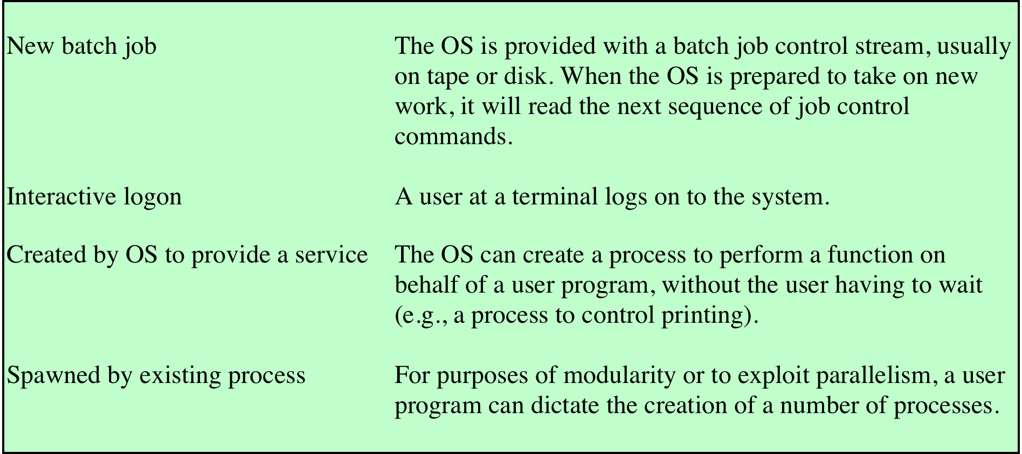
Table 3.1 Reasons for Process Creation
Notes:
When a new process is to be added to those currently being
managed, the OS builds the data structures that are used to manage the process
and allocates address space in main memory to the process. We describe these data
structures in Section 3.3 . These actions constitute the creation of a new process.
Four common events lead to the creation of a process, as indicated in Table 3.1 .
In a batch environment, a process is created in response to the submission of a job.
In an interactive environment, a process is created when a new user attempts to
log on. In both cases, the OS is responsible for the creation of the new process.
An OS may also create a process on behalf of an application. For example, if a
user requests that a file be printed, the OS can create a process that will manage
the printing. The requesting process can thus proceed independently of the time
required to complete the printing task.
Traditionally, the OS created all processes in a way that was transparent to the
user or application program, and this is still commonly found with many contemporary
operating systems. However, it can be useful to allow one process to cause
the creation of another. For example, an application process may generate another
process to receive data that the application is generating and to organize those data
into a form suitable for later analysis. The new process runs in parallel to the original
process and is activated from time to time when new data are available. This
arrangement can be very useful in structuring the application.

Slide 13
Process Creation
Process spawning
when the OS creates a process at the explicit request of another process
Parent process
is the original, creating, process
Child process
is the new process
Notes:
As another example,
a server process (e.g., print server, file server) may generate a new process for each
request that it handles. When the OS creates a process at the explicit request of
another process, the action is referred to as process spawning .
When one process spawns another, the former is referred to as the parent
process , and the spawned process is referred to as the child process . Typically, the
“related” processes need to communicate and cooperate with each other. Achieving
this cooperation is a difficult task for the programmer; this topic is discussed in
Chapter 5 .

Slide 14

Process Termination
There must be a means for a process to indicate its completion
A batch job should include a HALT instruction or an explicit OS service call for termination
For an interactive application, the action of the user will indicate when the process is completed (e.g. log off, quitting an application)
Notes:
Any computer system must provide a means for a process to indicate its
completion. A batch job should include a Halt instruction or an explicit OS service
call for termination. In the former case, the Halt instruction will generate an interrupt
to alert the OS that a process has completed. For an interactive application, the action
of the user will indicate when the process is completed. For example, in a time-sharing
system, the process for a particular user is to be terminated when the user logs off or
turns off his or her terminal. On a personal computer or workstation, a user may quit
an application (e.g., word processing or spreadsheet). All of these actions ultimately
result in a service request to the OS to terminate the requesting process.

Slide 15
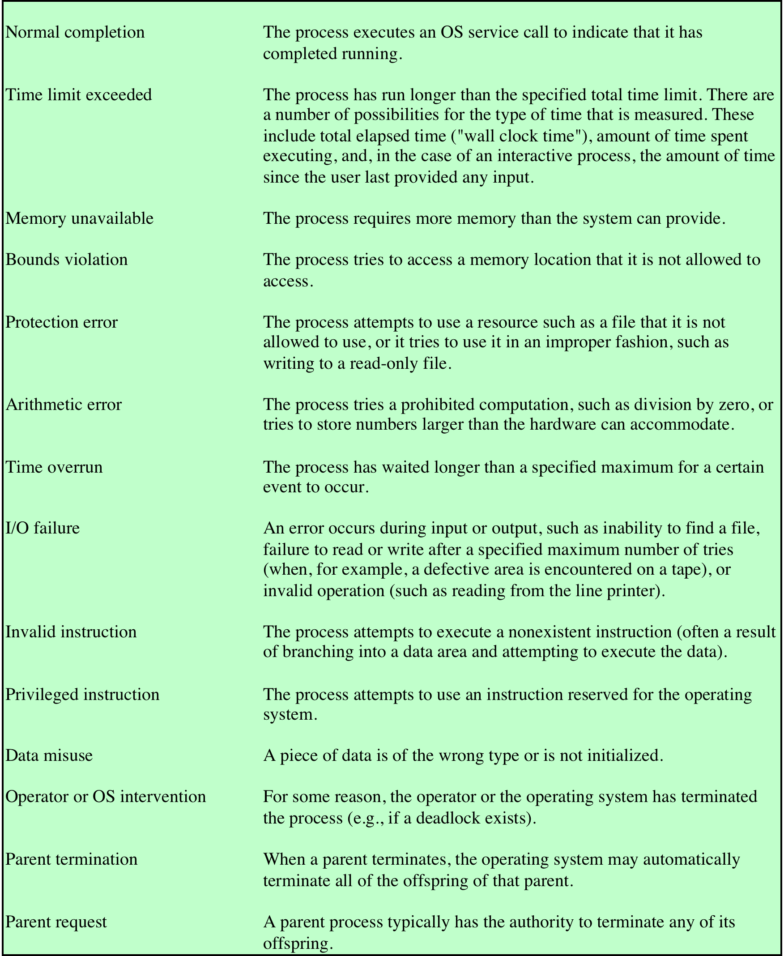
Table 3.2
Reasons for Process Termination
Notes:
Additionally, a number of error and fault conditions can lead to the termination
of a process. Table 3.2 lists some of the more commonly recognized conditions. 3
Finally, in some operating systems, a process may be terminated by the process
that created it or when the parent process is itself terminated.

Slide 16
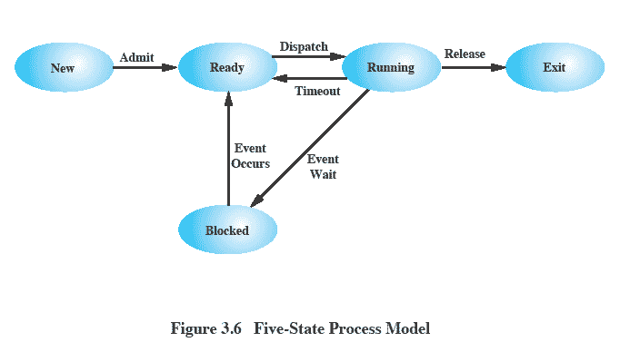
Five-State Process Model
Notes:
If all processes were always ready to execute, then the queuing discipline suggested
by Figure 3.5b would be effective. The queue is a first-in-first-out list and the processor
operates in round-robin fashion on the available processes (each process in
the queue is given a certain amount of time, in turn, to execute and then returned to
the queue, unless blocked). However, even with the simple example that we have
described, this implementation is inadequate: Some processes in the Not Running
state are ready to execute, while others are blocked, waiting for an I/O operation
to complete. Thus, using a single queue, the dispatcher could not just select the
process at the oldest end of the queue. Rather, the dispatcher would have to scan
the list looking for the process that is not blocked and that has been in the queue
the longest.
A more natural way to handle this situation is to split the Not Running state
into two states: Ready and Blocked. This is shown in Figure 3.6 .
The five states in this
new diagram are:
• Running: The process that is currently being executed. For this chapter, we
will assume a computer with a single processor, so at most one process at a
time can be in this state.
• Ready: A process that is prepared to execute when given the opportunity.
• Blocked/Waiting: 4 A process that cannot execute until some event occurs,
such as the completion of an I/O operation.
• New: A process that has just been created but has not yet been admitted to the
pool of executable processes by the OS. Typically, a new process has not yet
been loaded into main memory, although its process control block has been
created.
• Exit: A process that has been released from the pool of executable processes
by the OS, either because it halted or because it aborted for some reason.
Figure 3.6 indicates the types of events that lead to each state transition for a
process; the possible transitions are as follows:
• Null : New: A new process is created to execute a program. This event occurs
for any of the reasons listed in Table 3.1 .
• New : Ready: The OS will move a process from the New state to the Ready
state when it is prepared to take on an additional process. Most systems set
some limit based on the number of existing processes or the amount of virtual
memory committed to existing processes. This limit assures that there are not
so many active processes as to degrade performance.
• Ready : Running: When it is time to select a process to run, the OS chooses
one of the processes in the Ready state. This is the job of the scheduler or
dispatcher. Scheduling is explored in Part Four.
• Running : Exit: The currently running process is terminated by the OS if the
process indicates that it has completed, or if it aborts. See Table 3.2 .
• Running : Ready: The most common reason for this transition is that the
running process has reached the maximum allowable time for uninterrupted
execution; virtually all multiprogramming operating systems impose this type
of time discipline. There are several other alternative causes for this transition,
which are not implemented in all operating systems. Of particular importance
is the case in which the OS assigns different levels of priority to different
processes.
Running : Blocked: A process is put in the Blocked state if it requests something
for which it must wait. A request to the OS is usually in the form of a
system service call; that is, a call from the running program to a procedure
that is part of the operating system code. For example, a process may request
a service from the OS that the OS is not prepared to perform immediately. It
can request a resource, such as a file or a shared section of virtual memory,
that is not immediately available. Or the process may initiate an action, such
as an I/O operation, that must be completed before the process can continue.
When processes communicate with each other, a process may be blocked
when it is waiting for another process to provide data or waiting for a message
from another process.
• Blocked : Ready: A process in the Blocked state is moved to the Ready state
when the event for which it has been waiting occurs.
• Ready : Exit: For clarity, this transition is not shown on the state diagram. In
some systems, a parent may terminate a child’ process at any time. Also, if a parent
terminates, all child processes associated with that parent may be terminated.
• Blocked : Exit: The comments under the preceding item apply.

Slide 17
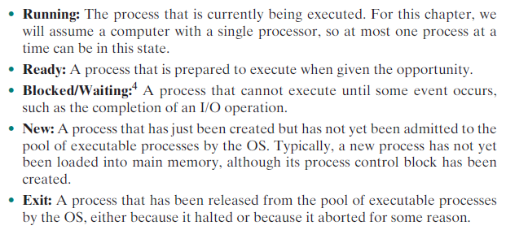
Five-State Process Model
Notes:
If all processes were always ready to execute, then the queuing discipline suggested
by Figure 3.5b would be effective. The queue is a first-in-first-out list and the processor
operates in round-robin fashion on the available processes (each process in
the queue is given a certain amount of time, in turn, to execute and then returned to
the queue, unless blocked). However, even with the simple example that we have
described, this implementation is inadequate: Some processes in the Not Running
state are ready to execute, while others are blocked, waiting for an I/O operation
to complete. Thus, using a single queue, the dispatcher could not just select the
process at the oldest end of the queue. Rather, the dispatcher would have to scan
the list looking for the process that is not blocked and that has been in the queue
the longest.
A more natural way to handle this situation is to split the Not Running state
into two states: Ready and Blocked. This is shown in Figure 3.6 .
The five states in this
new diagram are:
• Running: The process that is currently being executed. For this chapter, we
will assume a computer with a single processor, so at most one process at a
time can be in this state.
• Ready: A process that is prepared to execute when given the opportunity.
• Blocked/Waiting: 4 A process that cannot execute until some event occurs,
such as the completion of an I/O operation.
• New: A process that has just been created but has not yet been admitted to the
pool of executable processes by the OS. Typically, a new process has not yet
been loaded into main memory, although its process control block has been
created.
• Exit: A process that has been released from the pool of executable processes
by the OS, either because it halted or because it aborted for some reason.
Figure 3.6 indicates the types of events that lead to each state transition for a
process; the possible transitions are as follows:
• Null : New: A new process is created to execute a program. This event occurs
for any of the reasons listed in Table 3.1 .
• New : Ready: The OS will move a process from the New state to the Ready
state when it is prepared to take on an additional process. Most systems set
some limit based on the number of existing processes or the amount of virtual
memory committed to existing processes. This limit assures that there are not
so many active processes as to degrade performance.
• Ready : Running: When it is time to select a process to run, the OS chooses
one of the processes in the Ready state. This is the job of the scheduler or
dispatcher. Scheduling is explored in Part Four.
• Running : Exit: The currently running process is terminated by the OS if the
process indicates that it has completed, or if it aborts. See Table 3.2 .
• Running : Ready: The most common reason for this transition is that the
running process has reached the maximum allowable time for uninterrupted
execution; virtually all multiprogramming operating systems impose this type
of time discipline. There are several other alternative causes for this transition,
which are not implemented in all operating systems. Of particular importance
is the case in which the OS assigns different levels of priority to different
processes.
Running : Blocked: A process is put in the Blocked state if it requests something
for which it must wait. A request to the OS is usually in the form of a
system service call; that is, a call from the running program to a procedure
that is part of the operating system code. For example, a process may request
a service from the OS that the OS is not prepared to perform immediately. It
can request a resource, such as a file or a shared section of virtual memory,
that is not immediately available. Or the process may initiate an action, such
as an I/O operation, that must be completed before the process can continue.
When processes communicate with each other, a process may be blocked
when it is waiting for another process to provide data or waiting for a message
from another process.
• Blocked : Ready: A process in the Blocked state is moved to the Ready state
when the event for which it has been waiting occurs.
• Ready : Exit: For clarity, this transition is not shown on the state diagram. In
some systems, a parent may terminate a child’ process at any time. Also, if a parent
terminates, all child processes associated with that parent may be terminated.
• Blocked : Exit: The comments under the preceding item apply.

Slide 18
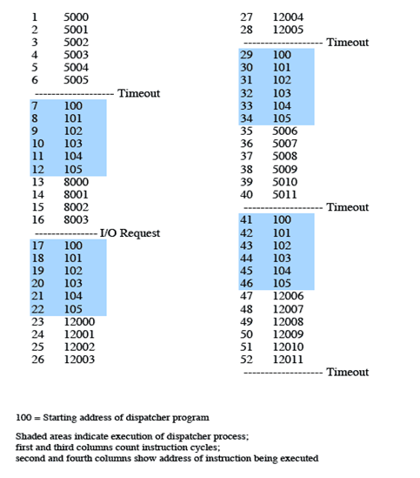
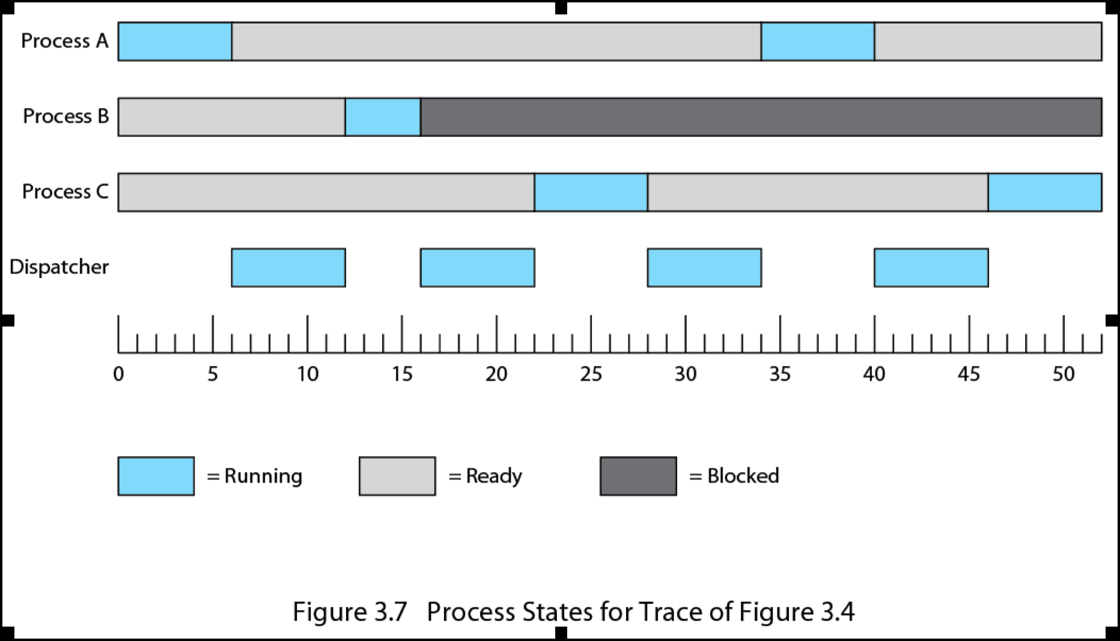
Process States for Trace of Figure 3.4
Notes:
Returning to our simple example, Figure 3.7 shows the transition of each process
among the states.

Slide 19
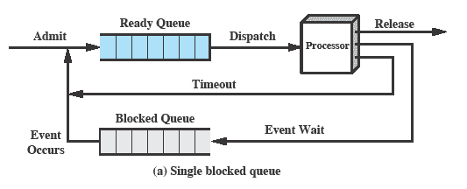
Using Two Queues
Notes:
Figure 3.8a suggests the way in which a queuing discipline
might be implemented with two queues: a Ready queue and a Blocked queue. As
each process is admitted to the system, it is placed in the Ready queue. When it is
time for the OS to choose another process to run, it selects one from the Ready
queue. In the absence of any priority scheme, this can be a simple first-in-first-out
queue. When a running process is removed from execution, it is either terminated
or placed in the Ready or Blocked queue, depending on the circumstances. Finally,
when an event occurs, any process in the Blocked queue that has been waiting on
that event only is moved to the Ready queue.

Slide 20
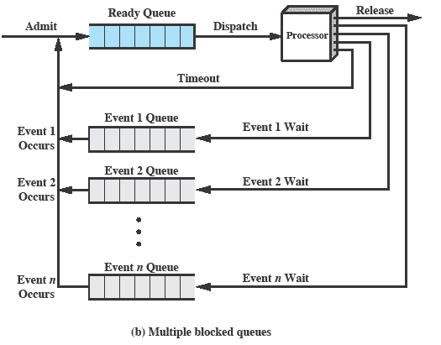
Multiple Blocked Queues
Notes:
This latter arrangement means that, when an event occurs, the OS must scan
the entire blocked queue, searching for those processes waiting on that event. In a
large OS, there could be hundreds or even thousands of processes in that queue.
Therefore, it would be more efficient to have a number of queues, one for each
event. Then, when the event occurs, the entire list of processes in the appropriate
queue can be moved to the Ready state ( Figure 3.8b ).
One final refinement: If the dispatching of processes is dictated by a priority
scheme, then it would be convenient to have a number of Ready queues, one for
each priority level. The OS could then readily determine which is the highest-priority
ready process that has been waiting the longest.

Slide 21
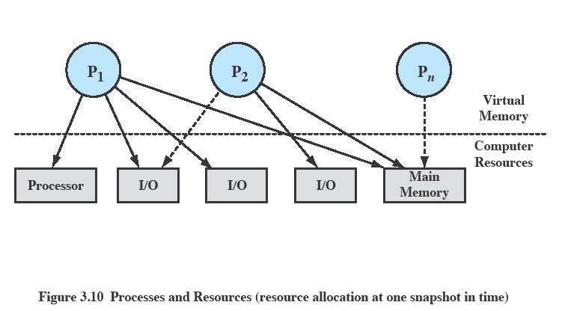
Process Description What does the OS need to know to manage processes & resources?
Notes:
The OS controls events within the computer system. It schedules and dispatches
processes for execution by the processor, allocates resources to processes, and
responds to requests by user processes for basic services. Fundamentally, we can
think of the OS as that entity that manages the use of system resources by processes.
This concept is illustrated in Figure 3.10 . In a multiprogramming environment,
there are a number of processes (P 1 ,…, P n ) that have been created and exist in
virtual memory. Each process, during the course of its execution, needs access to
certain system resources, including the processor, I/O devices, and main memory. In
the figure, process P 1 is running; at least part of the process is in main memory, and
it has control of two I/O devices. Process P 2 is also in main memory but is blocked
waiting for an I/O device allocated to P 1 . Process P n has been swapped out and is
therefore suspended.

Slide 22
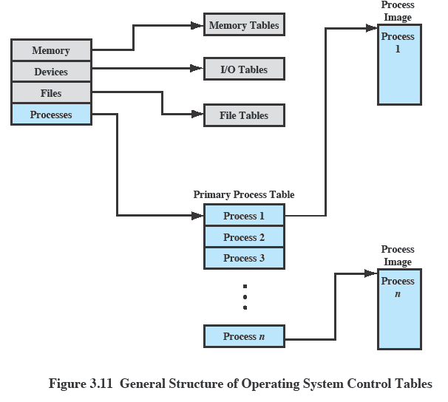
OS Control Tables
Notes:
If the OS is to manage processes and resources, it must have information about
the current status of each process and resource. The universal approach to providing
this information is straightforward: The OS constructs and maintains tables of
information about each entity that it is managing. A general idea of the scope of this
effort is indicated in Figure 3.11 , which shows four different types of tables maintained
by the OS: memory, I/O, file, and process. Although the details will differ
from one OS to another, fundamentally, all operating systems maintain information
in these four categories.
Figure 3.11 depicts the structure of the location information in the following
way. There is a primary process table with one entry for each process. Each
entry contains, at least, a pointer to a process image. If the process image contains
multiple blocks, this information is contained directly in the primary process
table or is available by cross-reference to entries in memory tables. Of course,
this depiction is generic; a particular OS will have its own way of organizing the
location information.

Slide 23
Memory Tables
Used to keep track of both main (real) and secondary (virtual) memory
Processes are maintained on secondary memory using some sort of virtual memory or simple swapping mechanism
Must include:
allocation of main memory to processes
allocation of secondary memory to processes
protection attributes of blocks of main or virtual memory
information needed to manage virtual memory
Notes:
Memory tables are used to keep track of both main (real) and secondary
(virtual) memory. Some of main memory is reserved for use by the OS; the
remainder is available for use by processes. Processes are maintained on secondary
memory using some sort of virtual memory or simple swapping mechanism. The
memory tables must include the following information:
• The allocation of main memory to processes
• The allocation of secondary memory to processes
Any protection attributes of blocks of main or virtual memory, such as which
processes may access certain shared memory regions
• Any information needed to manage virtual memory
We examine the information structures for memory management in detail in Part
Three.

Slide 24
I/O Tables
Used by the OS to manage the I/O devices and channels of the computer system
At any given time, an I/O device may be available or assigned to a particular process
If an I/O operation is in progress, the OS needs to know:
the status of the I/O operation
the location in main memory being used as the source or destination of the I/O transfer
Notes:
I/O tables are used by the OS to manage the I/O devices and channels of the
computer system. At any given time, an I/O device may be available or assigned to a
particular process. If an I/O operation is in progress, the OS needs to know the status
of the I/O operation and the location in main memory being used as the source or
destination of the I/O transfer. I/O management is examined in Chapter 11 .

Slide 25
File Tables
These tables provide information about:
existence of files
location on secondary memory
current status
other attributes
Information may be maintained and used by a file management system, or the OS itself
Notes:
The OS may also maintain file tables.
Much, if not all, of this information may be maintained and used by a file management system, in which case the OS has little or no knowledge of files.
In other operating systems, much of the detail of file management is managed by the OS itself.

Slide 26
Process Tables
Must be maintained to manage processes
Process tables must have some reference to memory, I/O, and file tables
e.g., pointers from each individual process entry to its data in the other three sets of tables.
The tables themselves must be accessible by the OS and therefore are subject to memory management
Processes are represented by a process image
Notes:
Finally, the OS must maintain process tables to manage processes. The
remainder of this section is devoted to an examination of the required process
tables. Before proceeding to this discussion, two additional points should be made.
First, although Figure 3.11 shows four distinct sets of tables, it should be clear that
these tables must be linked or cross-referenced in some fashion. Memory, I/O, and
files are managed on behalf of processes, so there must be some reference to these
resources, directly or indirectly, in the process tables. The files referred to in the file
tables are accessible via an I/O device and will, at some times, be in main or virtual
memory. The tables themselves must be accessible by the OS and therefore are subject
to memory management.
Second, how does the OS know to create the tables in the first place? Clearly,
the OS must have some knowledge of the basic environment, such as how much main
memory exists, what are the I/O devices and what are their identifiers, and so on. This
is an issue of configuration. That is, when the OS is initialized, it must have access to
some configuration data that define the basic environment, and these data must be
created outside the OS, with human assistance or by some auto configuration software.

Slide 27

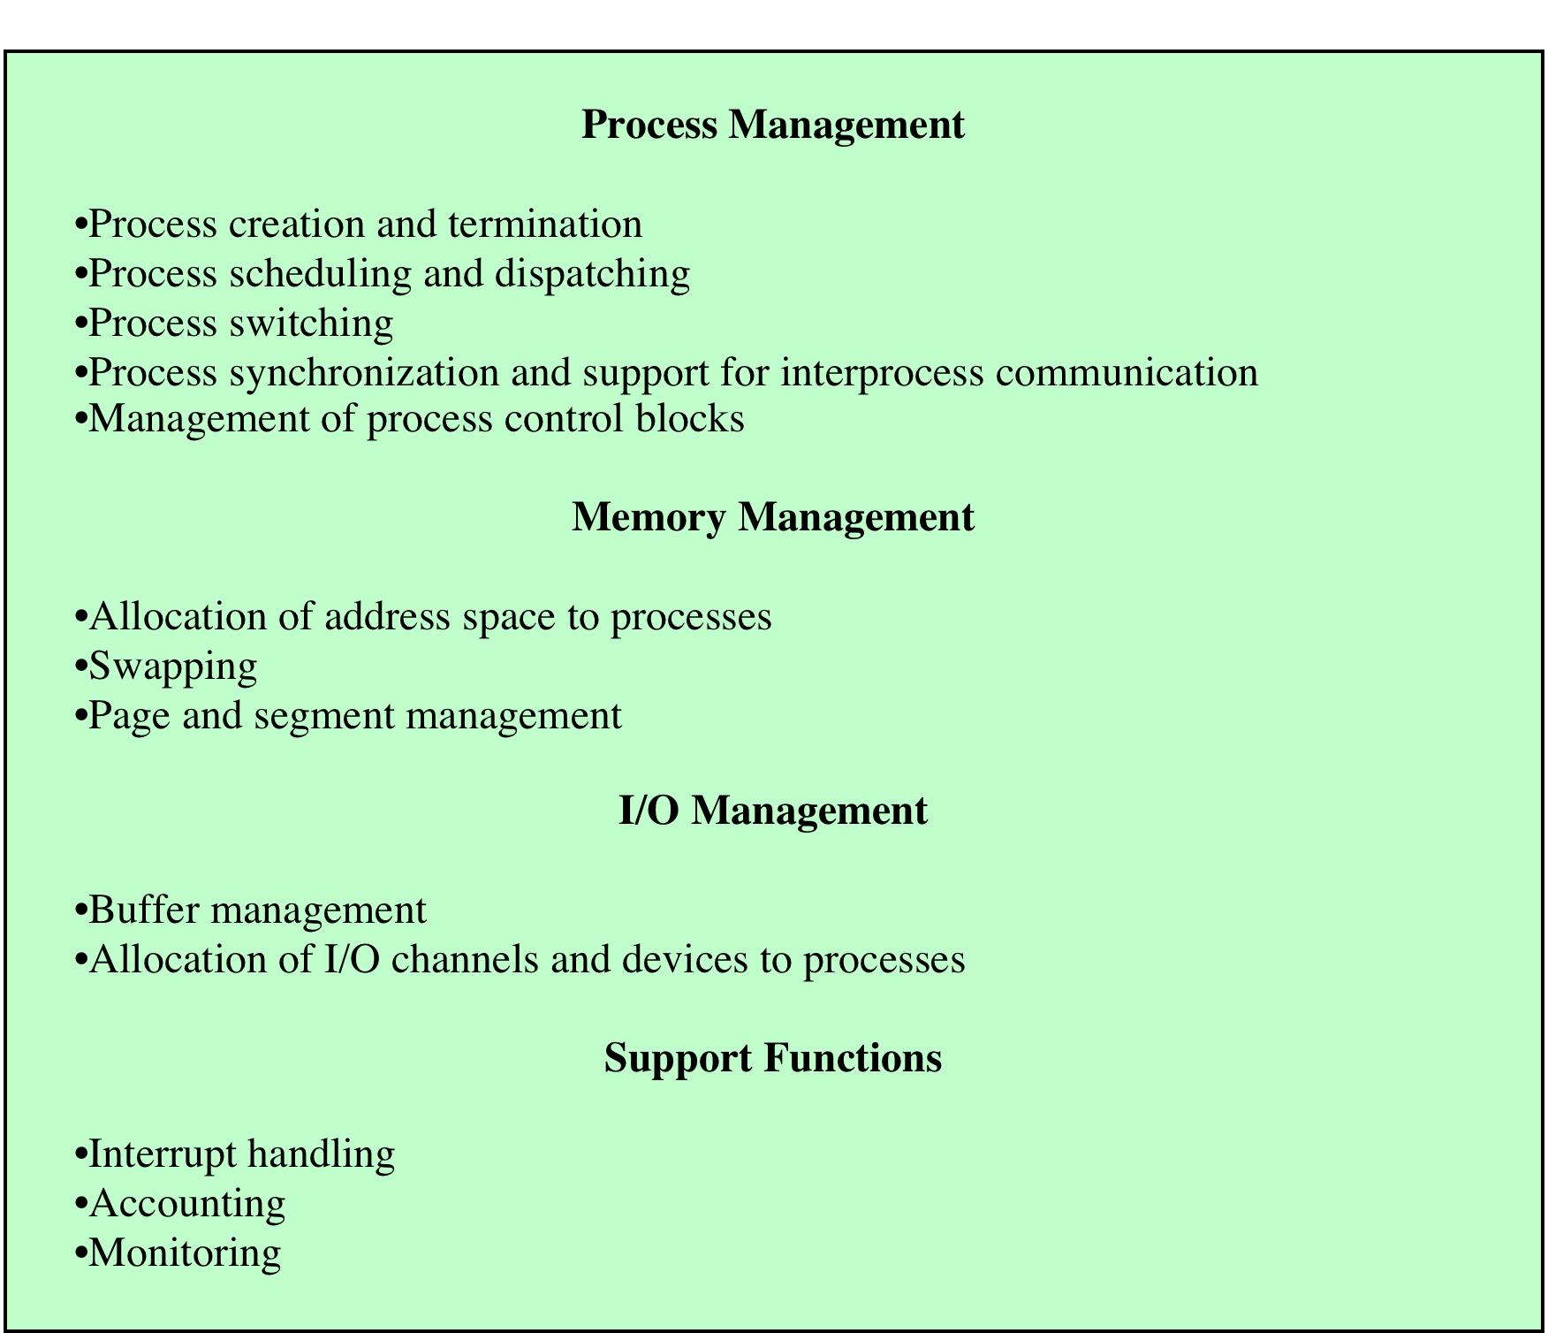
Table 3.7
Typical
Functions
of an
Operating
System
Kernel
Notes:
Table 3.7 lists the functions typically found in the kernel of an OS.

Slide 28
Operations on Process
Process Creation
Process (Context) Switching
Mode Switching
Change of Process State
Notes:
Once the OS decides, for whatever reason ( Table 3.1 ), to create a new process,
it can proceed as follows:
1. Assign a unique process identifier to the new process. At this time, a new entry
is added to the primary process table, which contains one entry per process.
2. Allocate space for the process. This includes all elements of the process image.
Thus, the OS must know how much space is needed for the private user address
space (programs and data) and the user stack. These values can be assigned by
default based on the type of process, or they can be set based on user request
at job creation time. If a process is spawned by another process, the parent
process can pass the needed values to the OS as part of the process-creation
request. If any existing address space is to be shared by this new process, the
appropriate linkages must be set up. Finally, space for a process control block
must be allocated.
3. Initialize the process control block. The process identification portion contains
the ID of this process plus other appropriate IDs, such as that of the parent
process. The processor state information portion will typically be initialized
with most entries zero, except for the program counter (set to the program
entry point) and system stack pointers (set to define the process stack boundaries).
The process control information portion is initialized based on standard
default values plus attributes that have been requested for this process. For
example, the process state would typically be initialized to Ready or Ready/
Suspend. The priority may be set by default to the lowest priority unless an
explicit request is made for a higher priority. Initially, the process may own
no resources (I/O devices, files) unless there is an explicit request for these or
unless they are inherited from the parent.
4. Set the appropriate linkages. For example, if the OS maintains each scheduling
queue as a linked list, then the new process must be put in the Ready or
Ready/Suspend list.
5. Create or expand other data structures. For example, the OS may maintain
an accounting file on each process to be used subsequently for billing and/or
performance assessment purposes.

Slide 29
Process Creation
Once the OS decides to create a new process it:
assigns a unique process identifier to the new process
allocates space for the process
initializes the process control block
sets the appropriate linkages
creates or expands other data structures
Notes:
Once the OS decides, for whatever reason ( Table 3.1 ), to create a new process,
it can proceed as follows:
1. Assign a unique process identifier to the new process. At this time, a new entry
is added to the primary process table, which contains one entry per process.
2. Allocate space for the process. This includes all elements of the process image.
Thus, the OS must know how much space is needed for the private user address
space (programs and data) and the user stack. These values can be assigned by
default based on the type of process, or they can be set based on user request
at job creation time. If a process is spawned by another process, the parent
process can pass the needed values to the OS as part of the process-creation
request. If any existing address space is to be shared by this new process, the
appropriate linkages must be set up. Finally, space for a process control block
must be allocated.
3. Initialize the process control block. The process identification portion contains
the ID of this process plus other appropriate IDs, such as that of the parent
process. The processor state information portion will typically be initialized
with most entries zero, except for the program counter (set to the program
entry point) and system stack pointers (set to define the process stack boundaries).
The process control information portion is initialized based on standard
default values plus attributes that have been requested for this process. For
example, the process state would typically be initialized to Ready or Ready/
Suspend. The priority may be set by default to the lowest priority unless an
explicit request is made for a higher priority. Initially, the process may own
no resources (I/O devices, files) unless there is an explicit request for these or
unless they are inherited from the parent.
4. Set the appropriate linkages. For example, if the OS maintains each scheduling
queue as a linked list, then the new process must be put in the Ready or
Ready/Suspend list.
5. Create or expand other data structures. For example, the OS may maintain
an accounting file on each process to be used subsequently for billing and/or
performance assessment purposes.

Slide 30
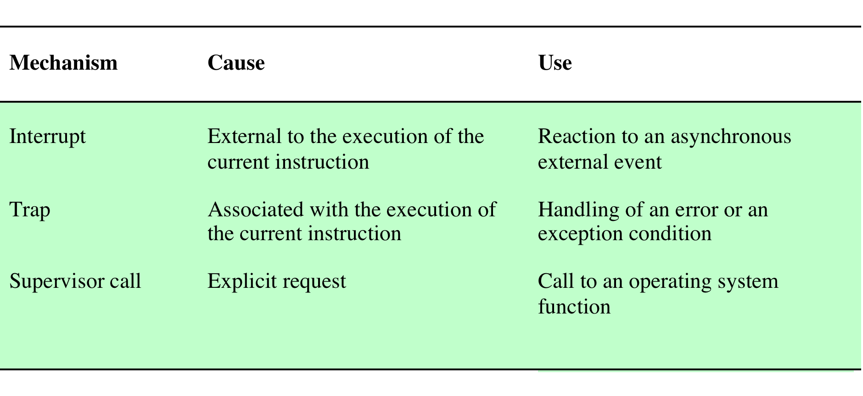
Process (Context) Switching
A process switch may occur any time that the OS has gained control from the currently running process. Possible events giving OS control are:
Notes:
A process switch may occur any time that the OS has
gained control from the currently running process. Table 3.8 suggests the possible
events that may give control to the OS.

Slide 31
System Interrupts
Interrupt
Trap
Due to some sort of event that is external to and independent of the currently running process
clock interrupt
I/O interrupt
memory fault
Time slice
the maximum amount of time that a process can execute before being interrupted
An error or exception condition generated within the currently running process
OS determines if the condition is fatal
moved to the Exit state and a process switch occurs
action will depend on the nature of the error
Notes:
First, let us consider system interrupts. Actually, we can distinguish, as many
systems do, two kinds of system interrupts, one of which is simply referred to as an
interrupt, and the other as a trap. The former is due to some sort of event that is
external to and independent of the currently running process, such as the completion
of an I/O operation. The latter relates to an error or exception condition generated
within the currently running process, such as an illegal file access attempt. With an
ordinary interrupt , control is first transferred to an interrupt handler, which does
some basic housekeeping and then branches to an OS routine that is concerned with
the particular type of interrupt that has occurred. Examples include the following:
• Clock interrupt: The OS determines whether the currently running process
has been executing for the maximum allowable unit of time, referred to as a
time slice . That is, a time slice is the maximum amount of time that a process
can execute before being interrupted. If so, this process must be switched to a
Ready state and another process dispatched.
• I/O interrupt: The OS determines what I/O action has occurred. If the I/O
action constitutes an event for which one or more processes are waiting,
then the OS moves all of the corresponding blocked processes to the Ready
state (and Blocked/Suspend processes to the Ready/Suspend state). The OS
must then decide whether to resume execution of the process currently in
the Running state or to preempt that process for a higher-priority Ready
process.
• Memory fault: The processor encounters a virtual memory address reference
for a word that is not in main memory. The OS must bring in the block
(page or segment) of memory containing the reference from secondary memory
to main memory. After the I/O request is issued to bring in the block of
memory, the process with the memory fault is placed in a blocked state; the
OS then performs a process switch to resume execution of another process.
After the desired block is brought into memory, that process is placed in the
Ready state.
With a trap , the OS determines if the error or exception condition is fatal.
If so, then the currently running process is moved to the Exit state and a process
switch occurs. If not, then the action of the OS will depend on the nature of
the error and the design of the OS. It may attempt some recovery procedure or
simply notify the user. It may do a process switch or resume the currently running
process.

Slide 32
Mode switching
A mode switch can take place without changing the state of executing process
Notes:
To distinguish the two characteristics, the unit of dispatching is usually referred to as a thread or lightweight process , while the unit of resource ownership is usually referred to as a process or task .
Multithreading refers to the ability of an OS to support multiple, concurrent paths of execution within a single process.

Slide 33
Change of Process State
The steps in a full process switch are:
save the context of the processor
update the process control block of the process currently in the Running state
move the process control block of this process to the appropriate queue
select another process for execution
update the process control block of the process selected
update memory management data structures
restore the context of the processor to that which existed at the time the selected process was last switched out
If the currently running process is to be moved to another state (Ready, Blocked, etc.), then the OS must make substantial changes in its environment
Notes:
It is clear, then, that the mode switch is a concept
distinct from that of the process switch. 10 A mode switch may occur without
changing the state of the process that is currently in the Running state. In that case,
the context saving and subsequent restoral involve little overhead. However, if the
currently running process is to be moved to another state (Ready, Blocked, etc.),
then the OS must make substantial changes in its environment. The steps involved
in a full process switch are as follows:
1. Save the context of the processor, including program counter and other
registers.
2. Update the process control block of the process that is currently in the
Running state. This includes changing the state of the process to one of the
other states (Ready; Blocked; Ready/Suspend; or Exit). Other relevant fields
must also be updated, including the reason for leaving the Running state and
accounting information.
3. Move the process control block of this process to the appropriate queue
(Ready; Blocked on Event i ; Ready/Suspend).
4. Select another process for execution; this topic is explored in Part Four.
5. Update the process control block of the process selected. This includes changing
the state of this process to Running.
6. Update memory management data structures. This may be required, depending
on how address translation is managed; this topic is explored in Part Three.
7. Restore the context of the processor to that which existed at the time the
selected process was last switched out of the Running state, by loading in the
previous values of the program counter and other registers.
Thus, the process switch, which involves a state change, requires more effort than a
mode switch.

Slide 34
Processes and Threads
A thread is a path of execution within a process. A process can contain multiple threads.
Multithreading - The ability of an OS to support multiple, concurrent paths of execution within a single process
In traditional operating systems, each process has an address space and a single thread of control.
There are frequently situations in which it is desirable to have, multiple threads of control in the same address space
Notes:
To distinguish the two characteristics, the unit of dispatching is usually referred to as a thread or lightweight process , while the unit of resource ownership is usually referred to as a process or task .
Multithreading refers to the ability of an OS to support multiple, concurrent paths of execution within a single process.

Slide 35
Reasons for having Threads
In many applications, multiple activities are going on at once. Some of these may block from time to time.
Threads lighter weight than processes, they are easier (i.e., faster) to create and destroy than processes.
Threads yield no performance gain when all of them are CPU bound, but when there is substantial computing and also substantial I/O, having threads allows these activities to overlap, thus speeding up the application
Notes:
To distinguish the two characteristics, the unit of dispatching is usually referred to as a thread or lightweight process , while the unit of resource ownership is usually referred to as a process or task .
Multithreading refers to the ability of an OS to support multiple, concurrent paths of execution within a single process.

Slide 36
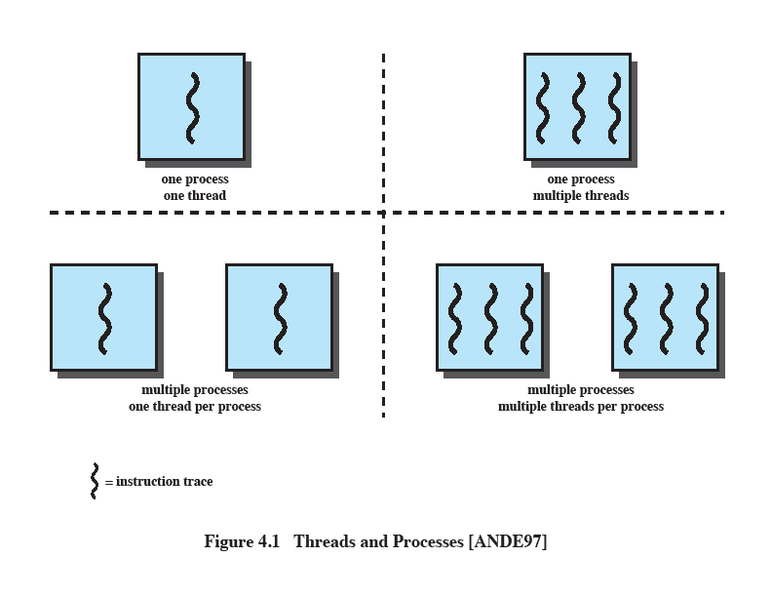
Single Threaded Approaches
A single execution path per process, in which the concept of a thread is not recognized, is referred to as a single-threaded approach
MS-DOS, some versions of UNIX supported only this type of process.
Notes:
The traditional approach of a single thread of execution per process, in which the concept of a thread is not recognized, is referred to as a single-threaded approach. The two arrangements shown in the left half of Figure 4.1 are single-threaded approaches. MS-DOS is an example of an OS that supports a single user process and a single thread.

Slide 37
Multithreaded Approaches
The right half of Figure 4.1 depicts multithreaded approaches
A Java run-time environment is a system of one process with multiple threads; Windows, some UNIXes, support multiple multithreaded processes.
Notes:
The right half of Figure 4.1 depicts multithreaded approaches. A Java run-time environment is an example of a system of one process with multiple threads. Of interest in this section is the use of multiple processes, each of which supports multiple threads. This approach is taken in Windows, Solaris, and many modern versions of UNIX, among others. In this section we give a general description of multithreading; the details of the Windows, Solaris, and Linux approaches are discussed later in this chapter.

Slide 38
Processes
In a multithreaded environment the process is the unit that owns resources and the unit of protection.
i.e., the OS provides protection at the process level
Processes have
A virtual address space that holds the process image
Protected access to
processors
other processes
files
I/O resources
Notes:
In a multithreaded environment, a process is defined as the unit of resource allocation and a unit of protection. The following are associated with processes:
• A virtual address space that holds the process image
• Protected access to processors, other processes (for interprocess communication), files, and I/O resources (devices and channels)

Slide 39
One or More Threads in a Process
Each thread has:
an execution state (Running, Ready, etc.)
saved thread context when not running (TCB)
an execution stack
some per-thread static storage for local variables
access to the shared memory and resources of its process (all threads of a process share this)
Notes:
Within a process, there may be one or more threads, each with the following:
• A thread execution state (Running, Ready, etc.)
• A saved thread context when not running; one way to view a thread is as an independent program counter operating within a process
• An execution stack
• Some per-thread static storage for local variables
• Access to the memory and resources of its process, shared with all other threads in that process

Slide 40
Benefits of Threads
Takes less time to create a new thread than a process
Less time to terminate a thread than a process
Switching between two threads takes less time than switching between processes
Threads enhance efficiency in communication between programs
Notes:
Thus, all of the threads of a process share the state and resources of that process. They reside in the same address space and have access to the same data. When one thread alters an item of data in memory, other threads see the results if and when they access that item. If one thread opens a file with read privileges, other threads in the same process can also read from that file.
The key benefits of threads derive from the performance implications:
1. It takes far less time to create a new thread in an existing process than to
create a brand-new process. Studies done by the Mach developers show that
thread creation is ten times faster than process creation in UNIX [TEVA87].
2. It takes less time to terminate a thread than a process.
3. It takes less time to switch between two threads within the same process than to switch between processes.
4. Threads enhance efficiency in communication between different executing programs. In most operating systems, communication between independent processes requires the intervention of the kernel to provide protection and the mechanisms needed for communication. However, because threads within the same process share memory and files, they can communicate with each other without invoking the kernel.
Thus, if there is an application or function that should be implemented as a set of related units of execution, it is far more efficient to do so as a collection of threads rather than a collection of separate processes.

Slide 41
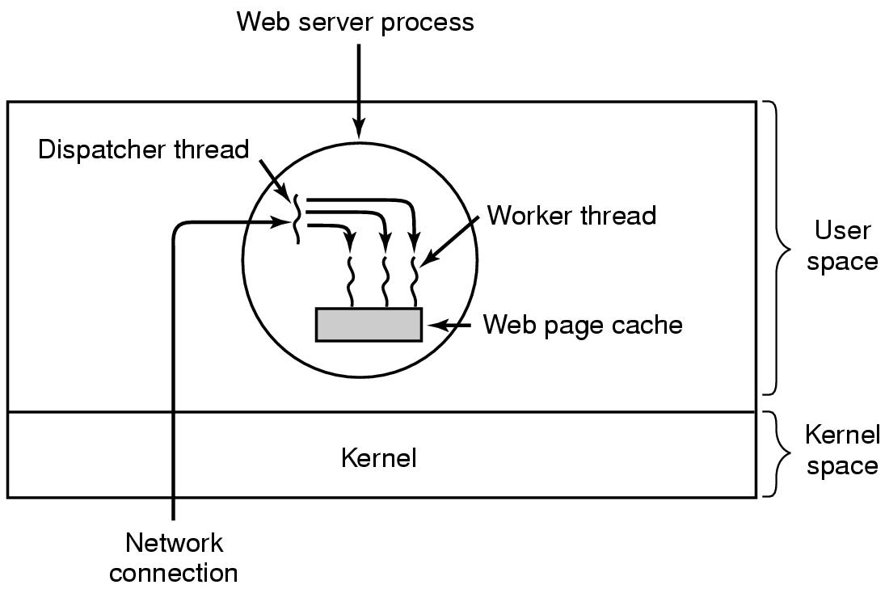
Thread Example-web server
.
.
Tanenbaum, Modern Operating Systems 3 e, (c) 2008 Prentice-Hall, Inc. All rights reserved. 0-13-6006639

Slide 42
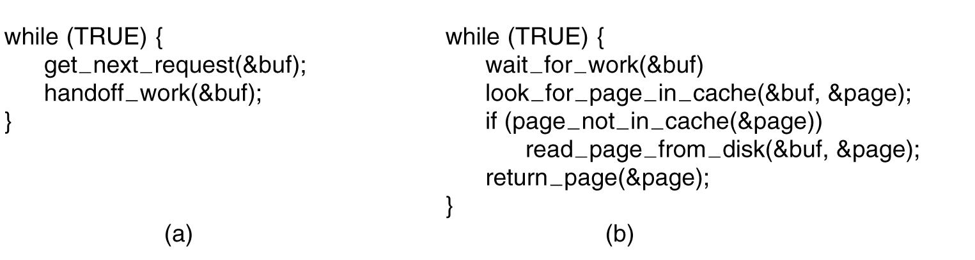
Web server code
(a) Dispatcher thread. (b) Worker thread.
Tanenbaum, Modern Operating Systems 3 e, (c) 2008 Prentice-Hall, Inc. All rights reserved. 0-13-6006639

Slide 43
Reasons to use threads
Enables parallelism (web server)
Threads are faster to create and destroy then processes
Easy programming model
Tanenbaum, Modern Operating Systems 3 e, (c) 2008 Prentice-Hall, Inc. All rights reserved. 0-13-6006639

Slide 44
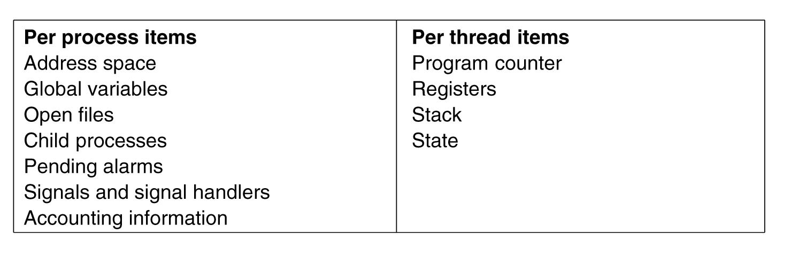
Threads are lightweight
Tanenbaum, Modern Operating Systems 3 e, (c) 2008 Prentice-Hall, Inc. All rights reserved. 0-13-6006639

Slide 45
Thread Execution States
Thread operations associated with a change in thread state are:
Spawn (create)
Block
Unblock
Finish
The key states for
a thread are:
Running
Ready
Blocked
Notes:
THREAD STATES
As with processes, the key states for a thread are Running, Ready, and Blocked. Generally, it does not make sense to associate suspend states with threads because such states are process-level concepts. In particular, if a process is swapped out, all of its threads are necessarily swapped out because they all share the address space of the process. There are four basic thread operations associated with a change in thread state [ANDE04]:
• Spawn: Typically, when a new process is spawned, a thread for that process is also spawned. Subsequently, a thread within a process may spawn another thread within the same process, providing an instruction pointer and arguments for the new thread. The new thread is provided with its own register context and stack space and placed on the ready queue.
• Block: When a thread needs to wait for an event, it will block (saving its user registers, program counter, and stack pointers). The processor may now turn to the execution of another ready thread in the same or a different process.
• Unblock: When the event for which a thread is blocked occurs, the thread is moved to the Ready queue.
• Finish: When a thread completes, its register context and stacks are deallocated.

Slide 46
Types of Threads
User Level Thread (ULT)
Kernel level Thread (KLT)
Notes:
User-Level and Kernel-Level Threads
There are two broad categories of thread implementation: user-level threads (ULTs) and kernel-level threads (KLTs). The latter are also referred to in the literature as kernel-supported threads or lightweight processes.

Slide 47
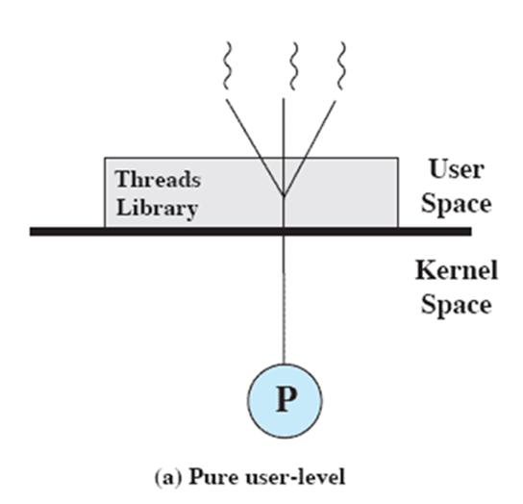
User-Level Threads (ULTs)
Thread management is done by the application
The kernel is not aware of the existence of threads
Not the kind we’ve discussed so far.
Notes:
USER-LEVEL THREADS
In a pure ULT facility, all of the work of thread management is done by the application and the kernel is not aware of the existence of threads. Figure 4.5a illustrates the pure ULT approach. Any application can be programmed to be multithreaded by using a threads library, which is a package of routines for ULT management. The threads library contains code for creating and destroying threads, for passing messages and data between threads, for scheduling thread execution, and for saving and restoring thread contexts.
By default, an application begins with a single thread and begins running in that thread. This application and its thread are allocated to a single process managed by the kernel. At any time that the application is running (the process is in the Running state), the application may spawn a new thread to run within the same process. Spawning is done by invoking the spawn utility in the threads library. Control is passed to that utility by a procedure call. The threads library creates a data structure for the new thread and then passes control to one of the threads within this process that is in the Ready state, using some scheduling algorithm. When control is passed to the library, the context of the current thread is saved, and when control is passed from the library to a thread, the context of that thread is restored. The context essentially consists of the contents of user registers, the program counter, and stack pointers.

Slide 48
Advantages of ULTs
Thread switching does not require kernel mode privileges (no mode switches)
Scheduling can be application specific
ULTs can run on any OS
Notes:
There are a number of advantages to the use of ULTs instead of KLTs, including the following:
1. Thread switching does not require kernel mode privileges because all of the
thread management data structures are within the user address space of a single process. Therefore, the process does not switch to the kernel mode to do thread management. This saves the overhead of two mode switches (user to kernel; kernel back to user).
2. Scheduling can be application specific. One application may benefit most
from a simple round-robin scheduling algorithm, while another might benefit from a priority-based scheduling algorithm. The scheduling algorithm can be tailored to the application without disturbing the underlying OS scheduler.
3. ULTs can run on any OS. No changes are required to the underlying kernel
to support ULTs. The threads library is a set of application-level functions shared by all applications.

Slide 49
Disadvantages of ULTs
In a typical OS many system calls are blocking
as a result, when a ULT executes a system call, not only is that thread blocked, but all of the threads within the process are blocked
In a pure ULT strategy, a multithreaded application cannot take advantage of multiprocessing
Notes:
There are two distinct disadvantages of ULTs compared to KLTs:
1. In a typical OS, many system calls are blocking. As a result, when a ULT
executes a system call, not only is that thread blocked, but also all of the threads within the process are blocked.
2. In a pure ULT strategy, a multithreaded application cannot take advantage
of multiprocessing. A kernel assigns one process to only one processor at a time. Therefore, only a single thread within a process can execute at a time. In effect, we have application-level multiprogramming within a single process. While this multiprogramming can result in a significant speedup of the application, there are applications that would benefit from the ability to execute portions of code simultaneously.

Slide 50
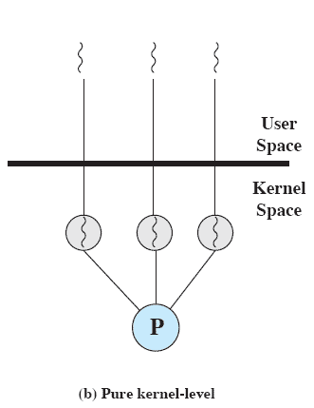
Kernel-Level Threads (KLTs)
Thread management is done by the kernel (could call them KMT)
no thread management is done by the application
Windows is an example of this approach
Notes:
KERNEL-LEVEL THREADS
In a pure KLT facility, all of the work of thread management is done by the kernel. There is no thread management code in the application level, simply an application programming interface (API) to the kernel thread facility. Windows is an example of this approach. Figure 4.5b depicts the pure KLT approach. The kernel maintains context
information for the process as a whole and for individual threads within the process.

Slide 51
Advantages of KLTs
The kernel can simultaneously schedule multiple threads from the same process on multiple processors
If one thread in a process is blocked, the kernel can schedule another thread of the same process
Notes:
Scheduling by the kernel is done on a thread basis. This approach overcomes the two principal drawbacks of the ULT approach. First, the kernel can simultaneously schedule multiple threads from the same process on multiple processors. Second, if one thread in a process is blocked, the kernel can schedule another thread of the same process. Another advantage of the KLT approach is that kernel routines themselves can be multithreaded.

Slide 52
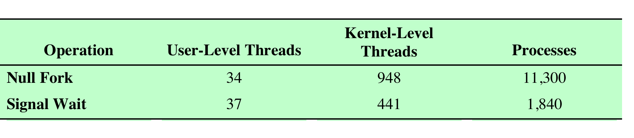
Disadvantage of KLTs
The transfer of control from one thread to another within the same process requires a mode switch to the kernel
Notes:
The principal disadvantage of the KLT approach compared to the ULT approach is that the transfer of control from one thread to another within the same process requires a mode switch to the kernel. To illustrate the differences, Table 4.1 shows the results of measurements taken on a uniprocessor VAX computer running a UNIX-like OS. The two benchmarks are as follows: Null Fork, the time to create, schedule, execute, and complete a process/thread that invokes the null procedure (i.e., the overhead of forking a process/thread); and Signal-Wait, the time for a process/thread to signal a waiting process/thread and then wait on a condition (i.e., the overhead of synchronizing two processes/threads together). We see that there is
an order of magnitude or more of difference between ULTs and KLTs and similarly between KLTs and processes.

Slide 53
Difference between ULT and KLT
User level thread | Kernel level thread
User thread are implemented by users. | kernel threads are implemented by OS.
OS doesn’t recognized user level threads. | Kernel threads are recognized by OS.
Implementation of User threads is easy. | Implementation of Kernel thread is complicated.
Context switch time is less. | Context switch time is more.
Context switch requires no hardware support. | Hardware support is needed.
If one user level thread perform blocking operation then entire process will be blocked. | If one kernel thread perform blocking operation then another thread can continue execution.
User level threads are designed as dependent threads. | Kernel level threads are designed as independent threads.
Example : Java thread, POSIX threads. | Example : Window Solaris.
Notes:
Scheduling by the kernel is done on a thread basis. This approach overcomes the two principal drawbacks of the ULT approach. First, the kernel can simultaneously schedule multiple threads from the same process on multiple processors. Second, if one thread in a process is blocked, the kernel can schedule another thread of the same process. Another advantage of the KLT approach is that kernel routines themselves can be multithreaded.

Slide 54
Multithreaded Process
Achieves concurrency without the overhead of using multiple processes
Threads within the same process can exchange information through their common address space and have access to the shared resources of the process
Threads in different processes can exchange information through shared memory that has been set up between the two processes
Notes:
Windows supports concurrency among processes because threads in different processes may execute concurrently (appear to run at the same time). Moreover, multiple threads within the same process may be allocated to separate processors and execute simultaneously (actually run at the same time). A multithreaded process achieves concurrency without the overhead of using multiple processes. Threads within the same process can exchange information through their common address space and have access to the shared resources of the process. Threads in different processes can exchange information through shared memory that has been set up between the two processes.
An object-oriented multithreaded process is an efficient means of implementing a server application. For example, one server process can service a number of clients concurrently.

Slide 55
Processor Scheduling
Aim is to assign processes to be executed by the processor in a way that meets system objectives, such as response time, throughput, and processor efficiency
Broken down into three separate functions:
long term scheduling
medium term scheduling
short term scheduling
Notes:
The aim of processor scheduling is to assign processes to be executed by the processor
or processors over time, in a way that meets system objectives, such as response
time, throughput, and processor efficiency. In many systems, this scheduling activity
is broken down into three separate functions: long-, medium-, and short-term
scheduling. The names suggest the relative time scales with which these functions are
performed.

Slide 56
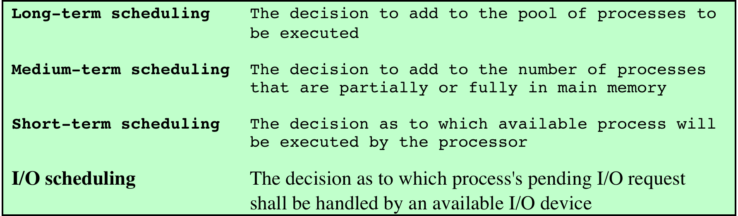
Table 9.1 Types of Scheduling
Notes:
The key to multiprogramming is scheduling. In fact, four types of scheduling
are typically involved ( Table 9.1 ). One of these, I/O scheduling, is more conveniently
addressed in Chapter 11 , where I/O is discussed. The remaining three types of scheduling,
which are types of processor scheduling, are addressed in this chapter and the next.

Slide 57
Long-Term Scheduler
Determines which programs are admitted to the system for processing
Controls the degree of multiprogramming
the more processes that are created, the smaller the percentage of time that each process can be executed
may limit to provide satisfactory service to the current set of processes
Creates processes from the queue when it can, but must decide:
when the operating system can take on one or more additional processes
which jobs to accept and turn into processes
first come, first served
priority, expected execution time, I/O requirements
Notes:
The long-term scheduler determines which programs are admitted to the system for
processing. Thus, it controls the degree of multiprogramming. Once admitted, a job
or user program becomes a process and is added to the queue for the short-term
scheduler. In some systems, a newly created process begins in a swapped-out condition,
in which case it is added to a queue for the medium-term scheduler.
In a batch system, or for the batch portion of a general-purpose operating
system, newly submitted jobs are routed to disk and held in a batch queue. The long-term
scheduler creates processes from the queue when it can. There are two decisions
involved here. First, the scheduler must decide when the operating system can take
on one or more additional processes. Second, the scheduler must decide which job
or jobs to accept and turn into processes.
The decision as to when to create a new process is generally driven by the
desired degree of multiprogramming. The more processes that are created, the
smaller is the percentage of time that each process can be executed (i.e., more processes
are competing for the same amount of processor time). Thus, the long-term
scheduler may limit the degree of multiprogramming to provide satisfactory service
to the current set of processes. Each time a job terminates, the scheduler may decide
to add one or more new jobs. Additionally, if the fraction of time that the processor
is idle exceeds a certain threshold, the long-term scheduler may be invoked.
The decision as to which job to admit next can be on a simple first-comefirst-
served (FCFS) basis, or it can be a tool to manage system performance. The
criteria used may include priority, expected execution time, and I/O requirements.
For example, if the information is available, the scheduler may attempt to keep a
mix of processor-bound and I/O-bound processes. 2 Also, the decision can depend
on which I/O resources are to be requested, in an attempt to balance I/O usage.
For interactive programs in a time-sharing system, a process creation request
can be generated by the act of a user attempting to connect to the system. Timesharing
users are not simply queued up and kept waiting until the system can accept
them. Rather, the operating system will accept all authorized comers until the
system is saturated, using some predefined measure of saturation. At that point, a
connection request is met with a message indicating that the system is full and the
user should try again later.

Slide 58
Medium-Term Scheduling
Part of the swapping function
Swapping-in decisions are based on the need to manage the degree of multiprogramming
considers the memory requirements of the swapped-out processes
Notes:
Medium-term scheduling is part of the swapping function. The issues involved are
discussed in Chapters 3 , 7 , and 8 . Typically, the swapping-in decision is based on
the need to manage the degree of multiprogramming. On a system that does not
use virtual memory, memory management is also an issue. Thus, the swapping-in
decision will consider the memory requirements of the swapped-out processes.

Slide 59
Short-Term Scheduling
Known as the dispatcher
Executes most frequently
Makes the fine-grained decision of which process to execute next
Invoked when an event occurs that leads to the blocking of the current process or that may provide an opportunity to preempt a currently running process in favor of another
Examples:
Clock interrupts
I/O interrupts
Operating system calls
Signals (e.g., semaphores)
Notes:
In terms of frequency of execution, the long-term scheduler executes relatively
infrequently and makes the coarse-grained decision of whether or not to take on
a new process and which one to take. The medium-term scheduler is executed
somewhat more frequently to make a swapping decision. The short-term scheduler,
also known as the dispatcher, executes most frequently and makes the fine-grained
decision of which process to execute next.
The short-term scheduler is invoked whenever an event occurs that may lead
to the blocking of the current process or that may provide an opportunity to preempt
a currently running process in favor of another. Examples of such events include
• Clock interrupts
• I/O interrupts
• Operating system calls
• Signals (e.g., semaphores)

Slide 60
Short Term Scheduling Criteria
Main objective is to allocate processor time to optimize certain aspects of system behavior
A set of criteria is needed to evaluate the scheduling policy
User-oriented criteria
relate to the behavior of the system as perceived by the individual user or process (such as response time in an interactive system)
important on virtually all systems
System-oriented criteria
focus in on effective and efficient utilization of the processor (rate at which processes are completed)
generally of minor importance on single-user systems
Notes:
The main objective of short-term scheduling is to allocate processor time in such
a way as to optimize one or more aspects of system behavior. Generally, a set of
criteria is established against which various scheduling policies may be evaluated.
The commonly used criteria can be categorized along two dimensions. First,
we can make a distinction between user-oriented and system-oriented criteria.
User-oriented criteria relate to the behavior of the system as perceived by the
individual user or process. An example is response time in an interactive system.
Response time is the elapsed time between the submission of a request until the
response begins to appear as output. This quantity is visible to the user and is
naturally of interest to the user. We would like a scheduling policy that provides
“good” service to various users. In the case of response time, a threshold may be
defined, say two seconds. Then a goal of the scheduling mechanism should be to
maximize the number of users who experience an average response time of two
seconds or less.
Other criteria are system oriented. That is, the focus is on effective and
efficient utilization of the processor. An example is throughput, which is the rate
at which processes are completed. This is certainly a worthwhile measure of system
performance and one that we would like to maximize. However, it focuses on
system performance rather than service provided to the user. Thus, throughput is of
concern to a system administrator but not to the user population.
Whereas user-oriented criteria are important on virtually all systems, systemoriented
criteria are generally of minor importance on single-user systems. On a
single-user system, it probably is not important to achieve high processor utilization
or high throughput as long as the responsiveness of the system to user applications
is acceptable.

Slide 61
Short-Term Scheduling Criteria: Performance
Criteria can be classified into:
Performance-related
quantitative
easily measured
Non-performance related
qualitative
hard to measure
examples:
response time
throughput
example:
predictability
Notes:
Another dimension along which criteria can be classified is those that
are performance related and those that are not directly performance related.
Performance-related criteria are quantitative and generally can be readily measured.
Examples include response time and throughput. Criteria that are not
performance related are either qualitative in nature or do not lend themselves readily
to measurement and analysis. An example of such a criterion is predictability. We
would like for the service provided to users to exhibit the same characteristics over
time, independent of other work being performed by the system. To some extent,
this criterion can be measured by calculating variances as a function of workload.
However, this is not nearly as straightforward as measuring throughput or response
time as a function of workload.

Slide 62
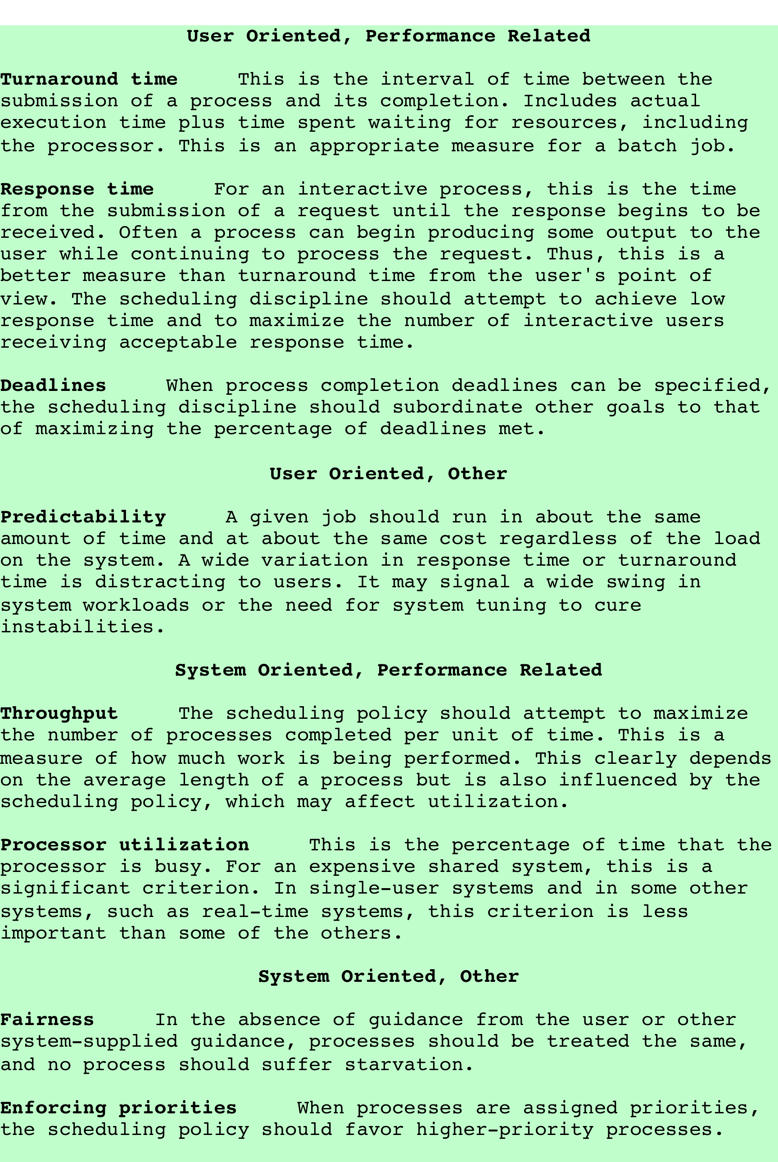
Table 9.2 Scheduling Criteria
Notes:
Table 9.2 summarizes key scheduling criteria. These are interdependent, and
it is impossible to optimize all of them simultaneously. For example, providing good
response time may require a scheduling algorithm that switches between processes
frequently. This increases the overhead of the system, reducing throughput. Thus,
the design of a scheduling policy involves compromising among competing requirements;
the relative weights given the various requirements will depend on the
nature and intended use of the system.
In most interactive operating systems, whether single user or time shared, adequate
response time is the critical requirement. Because of the importance of this
requirement, and because the definition of adequacy will vary from one application
to another, the topic is explored further in Appendix G .

Slide 63
Selection Function
Determines which Ready process is dispatched next
May be based on priority, resource requirements, or the execution characteristics of the process
If based on execution characteristics, some factors to consider are
w = time spent in system so far, waiting
e = time spent in execution so far
s = total service time required by the process, including e; (estimated by system or user)
Notes:
. The selection function determines which
process, among ready processes, is selected next for execution. The function may
be based on priority, resource requirements, or the execution characteristics of the
process. In the latter case, three quantities are significant:
w = time spent in system so far, waiting
e = time spent in execution so far
s = total service time required by the process, including e ; generally, this quantity
must be estimated or supplied by the user
For example, the selection function max[ w ] indicates an FCFS discipline.

Slide 64
Decision Mode
Two categories:
Nonpreemptive
Preemptive
When/under what circumstances is the selection function is exercised?
Notes:
The decision mode specifies the instants in time at which the selection function
is exercised. There are two general categories: nonpreemptive and preemptive

Slide 65
Nonpreemptive vs Preemptive
Nonpreemptive
Preemptive
once a process is in the running state, it will continue until it terminates or blocks itself for I/O
currently running process may be interrupted and moved to ready state by the OS
preemption may occur when a new process arrives, on an interrupt, or periodically
Notes:
Non-preemptive
In this case, once a process is in the Running state, it continues to execute until
it terminates or
it blocks itself to wait for I/O or to request some operating system service.
Preemptive:
The currently running process may be interrupted and moved to the Ready state by the operating system.
The decision to preempt may be performed
when a new process arrives;
when an interrupt occurs that places a blocked process in the Ready state;
or periodically, based on a clock interrupt.

